Slide 1














PROJECT
Merna Atef
field training
Year 3

Slide 2



Learning OBJECTIVES
01
02
03
04
Give an overview of the qualities, style and formality of ASMR .
Listener to ASMR can 22% be produvtive when listening to ASMR during work.
For all those readers , engineers ,creators , students and designers who want a focus and relaxing environment to do productively .
Online environmental platform .
Add a up to date custom-made Spotify playlist for each type of people.

Slide 3

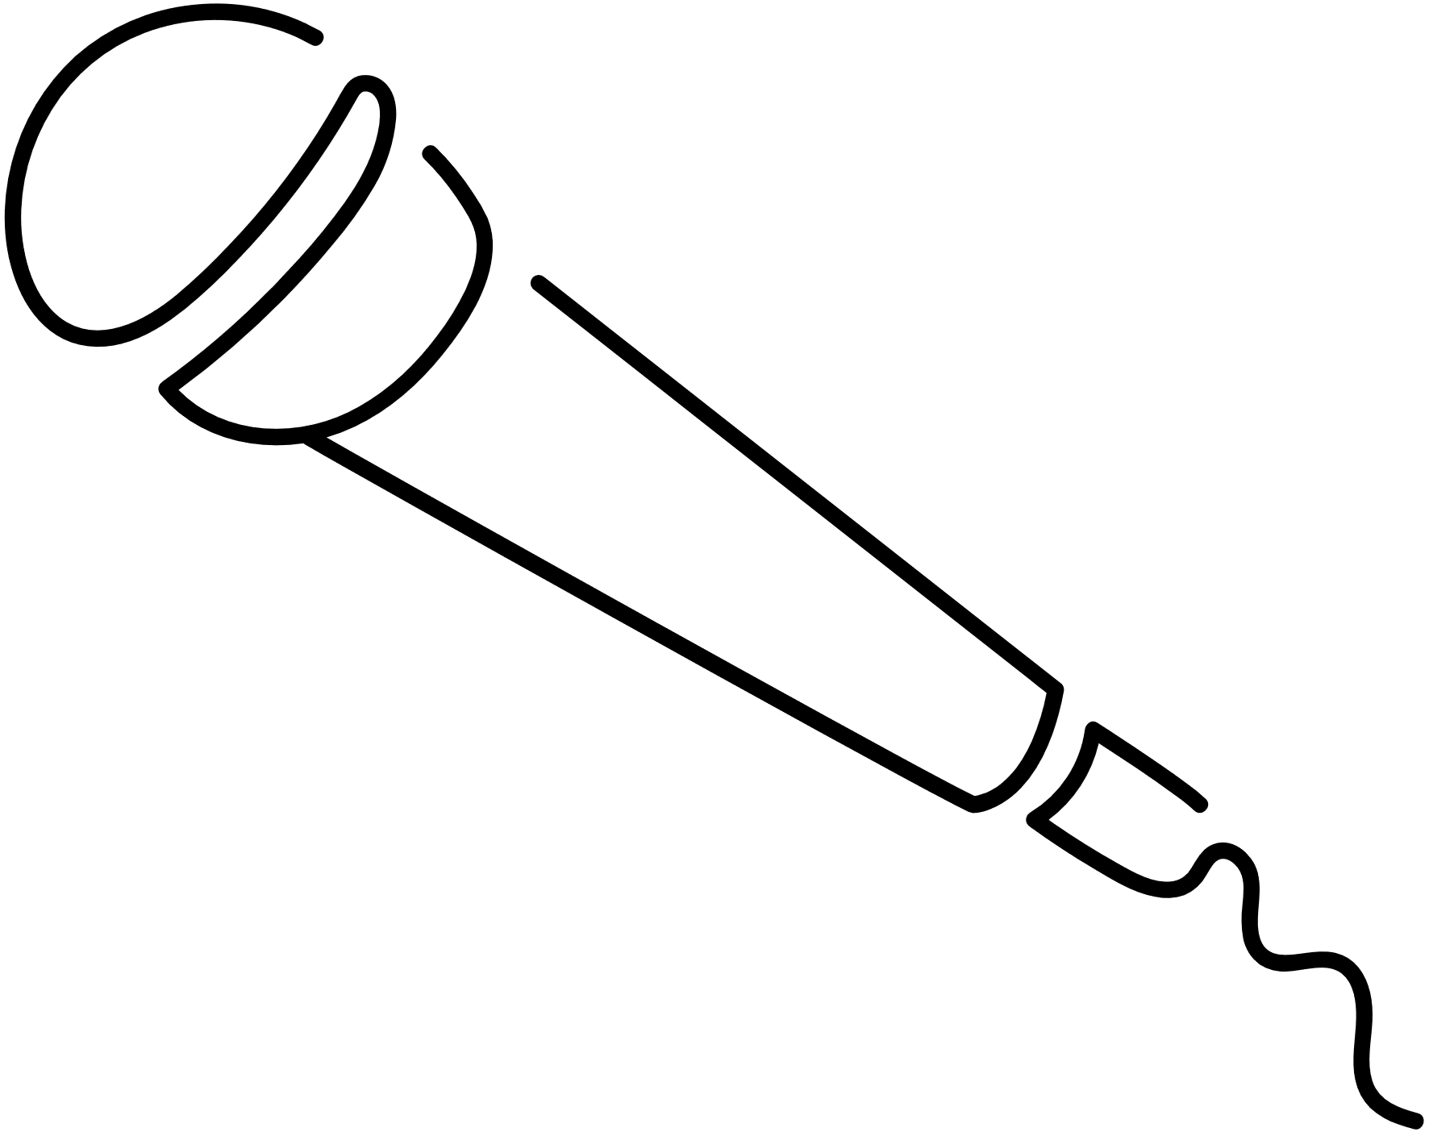
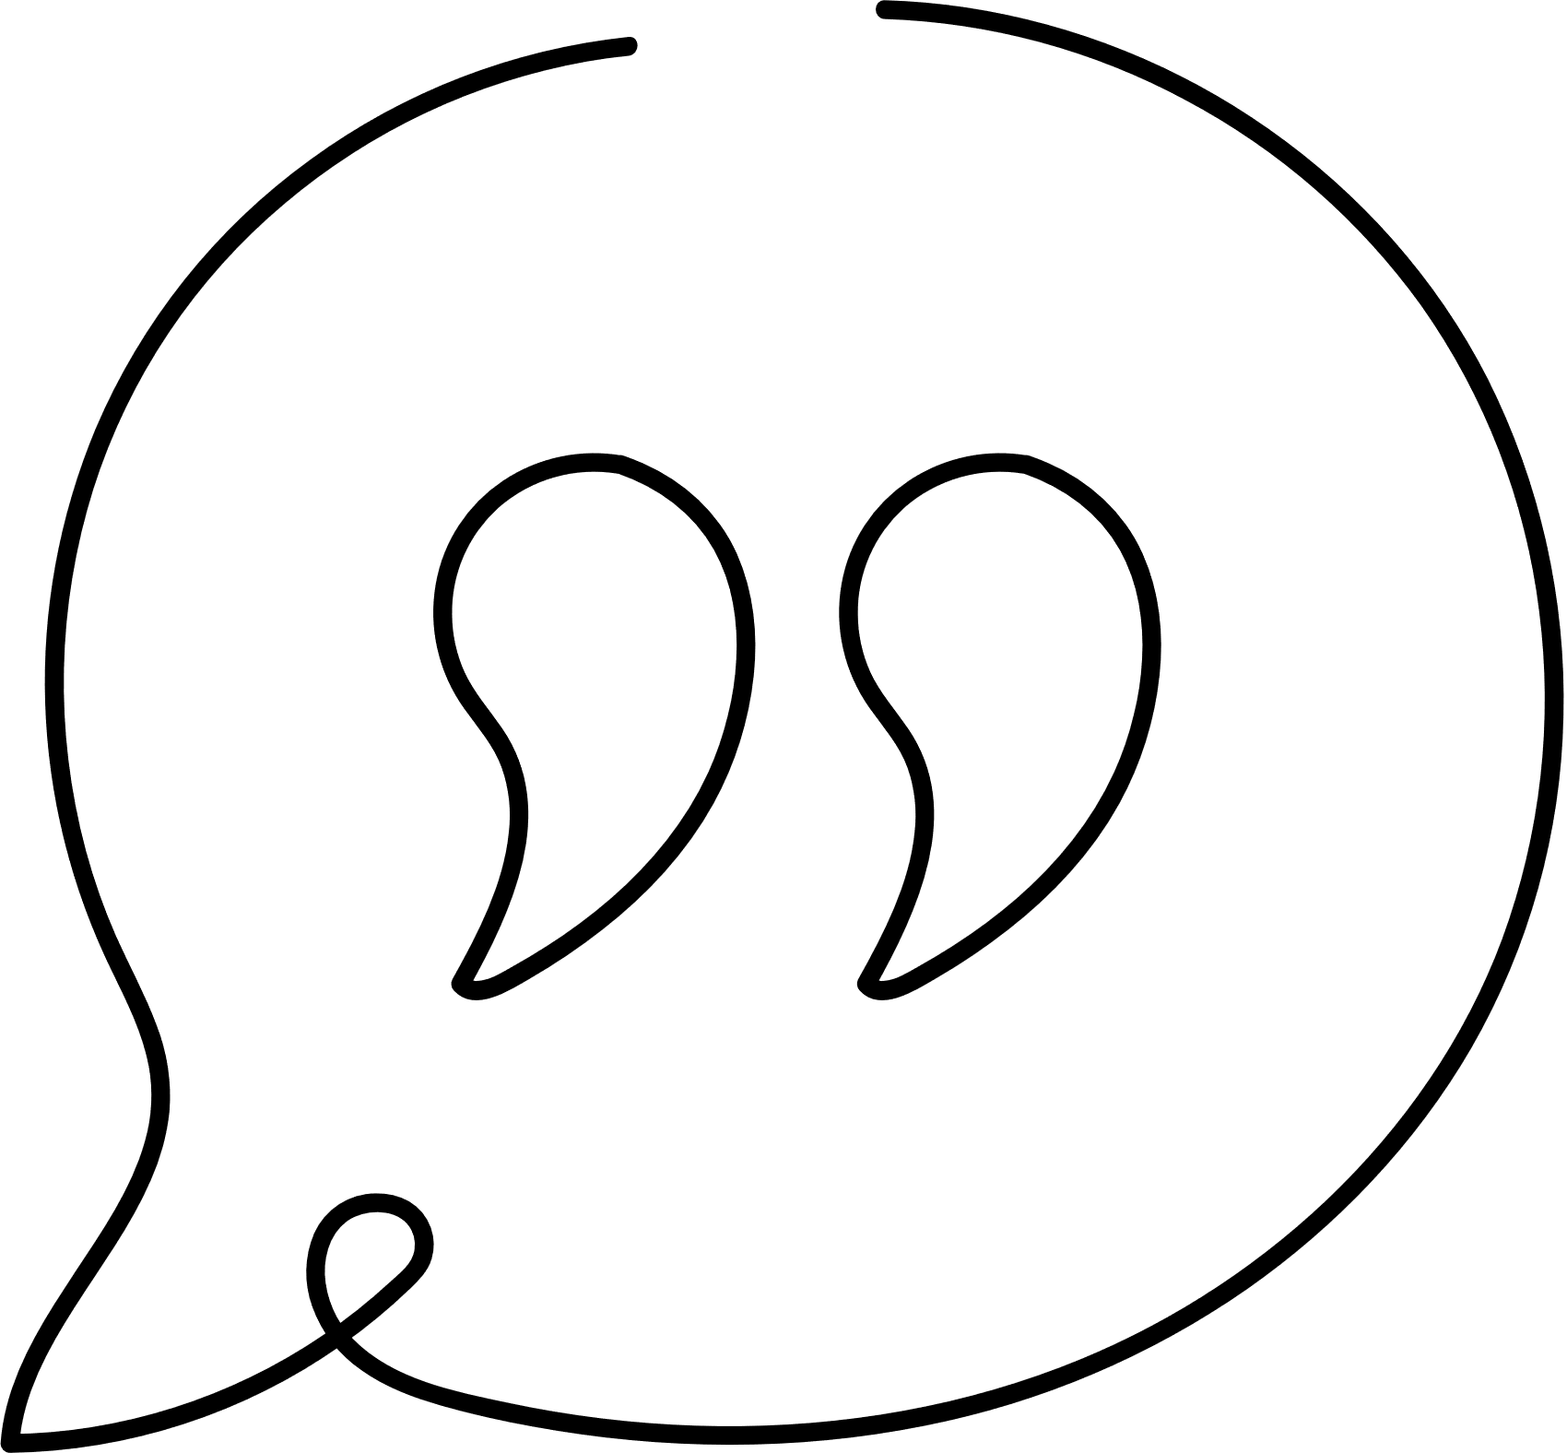
Methodology
HTML , CSS , JS environment website
1.
2.
personality test website
3.
spotify API
4.
Style, Tone and Formality
5.
Primary & Secondary Sources

Slide 4
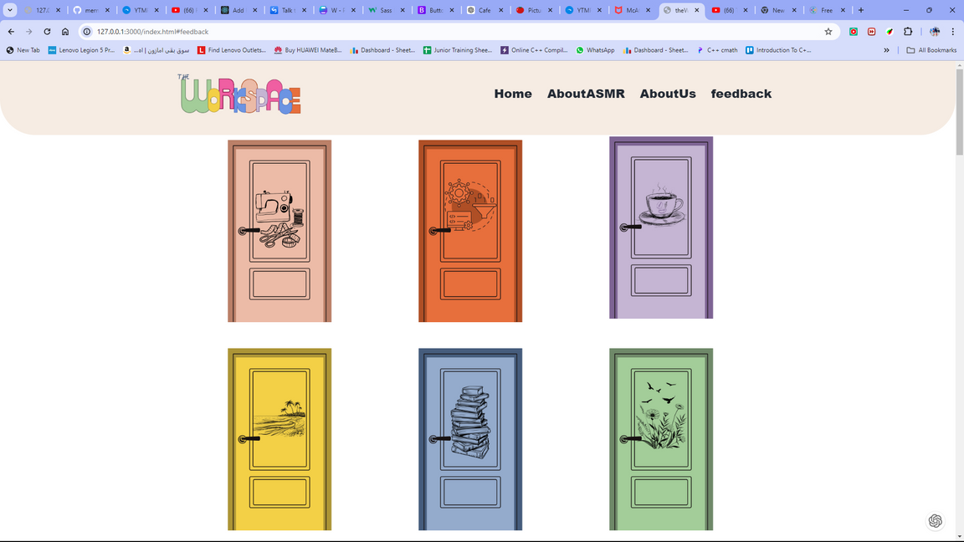
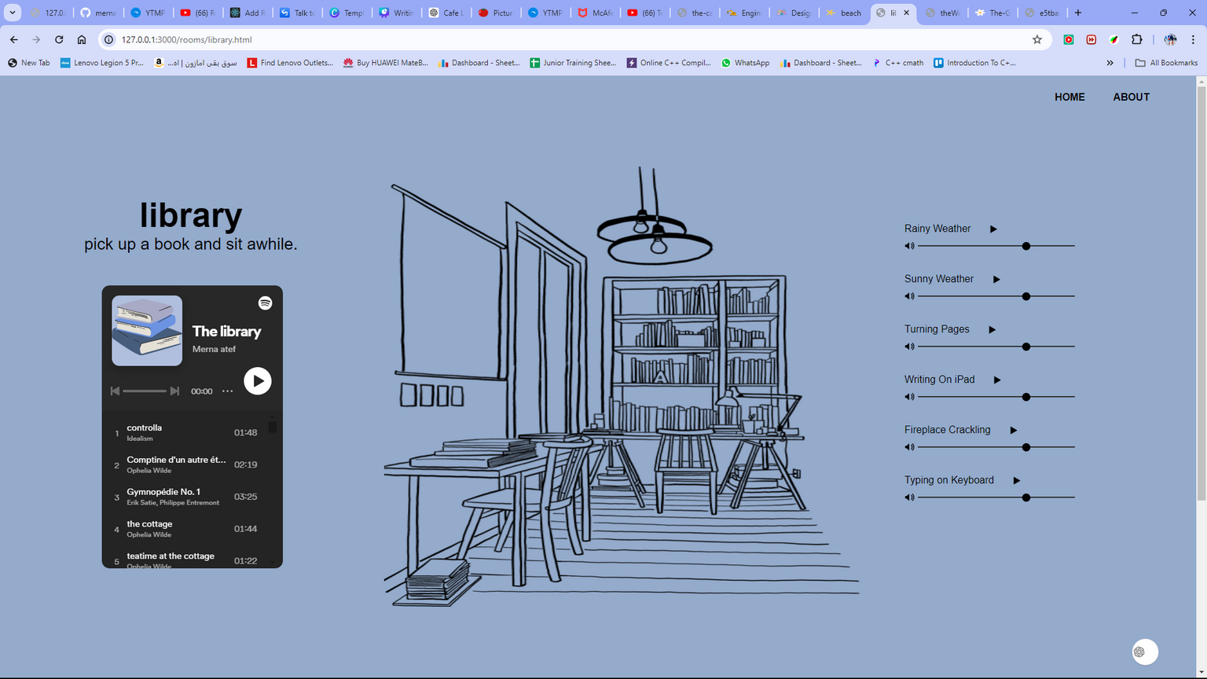
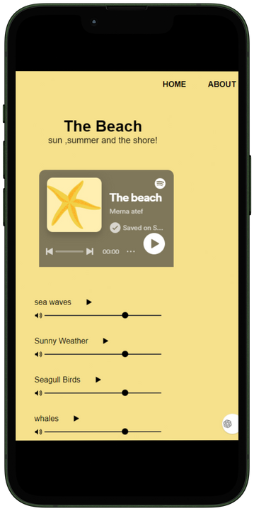

Slide 5
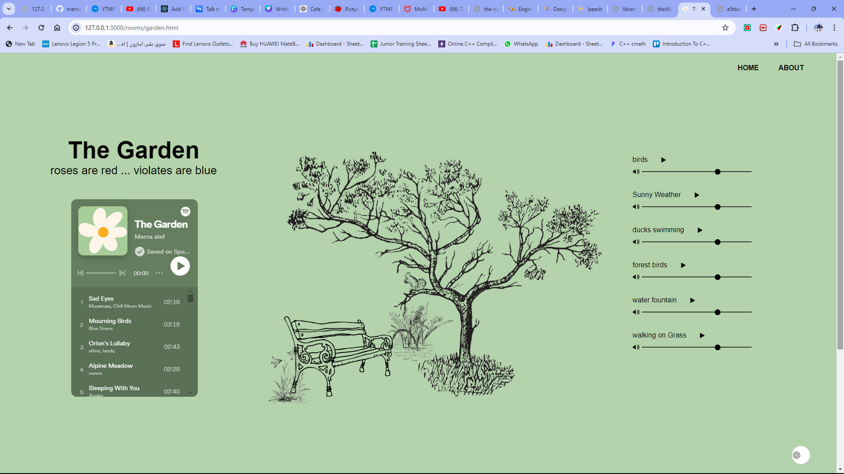

Slide 6
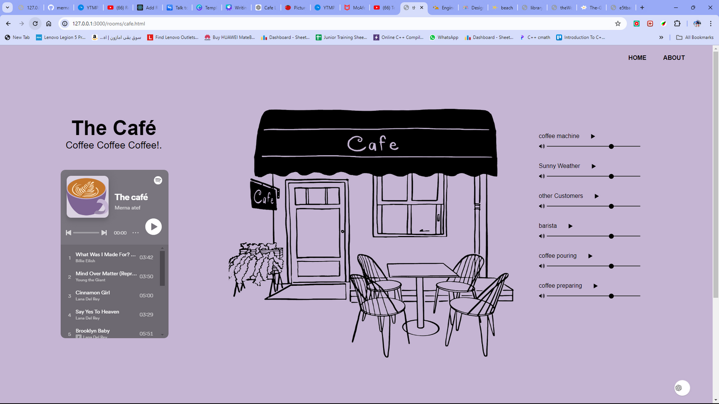

Slide 7
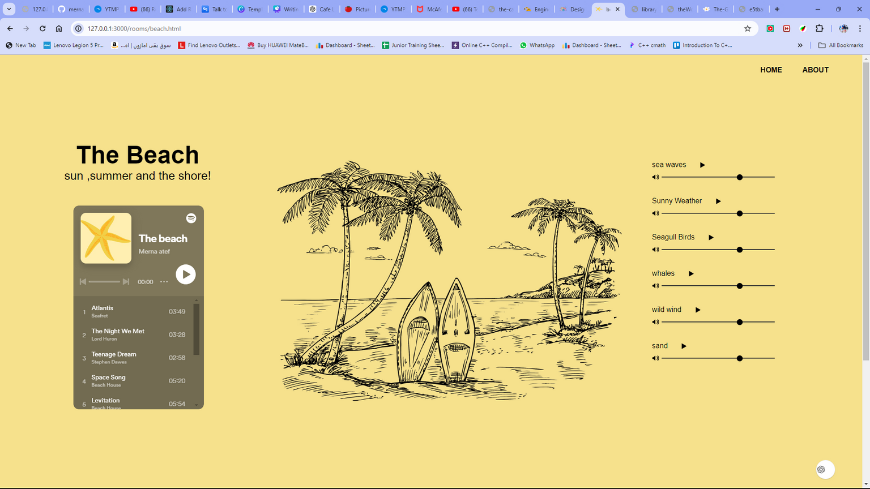

Slide 9
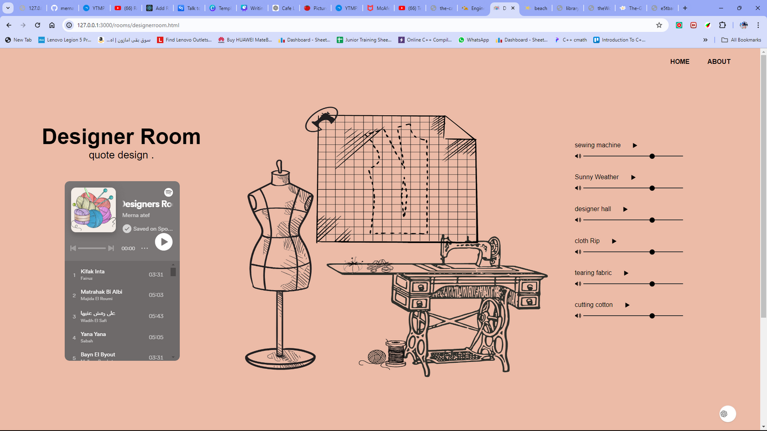

Slide 10
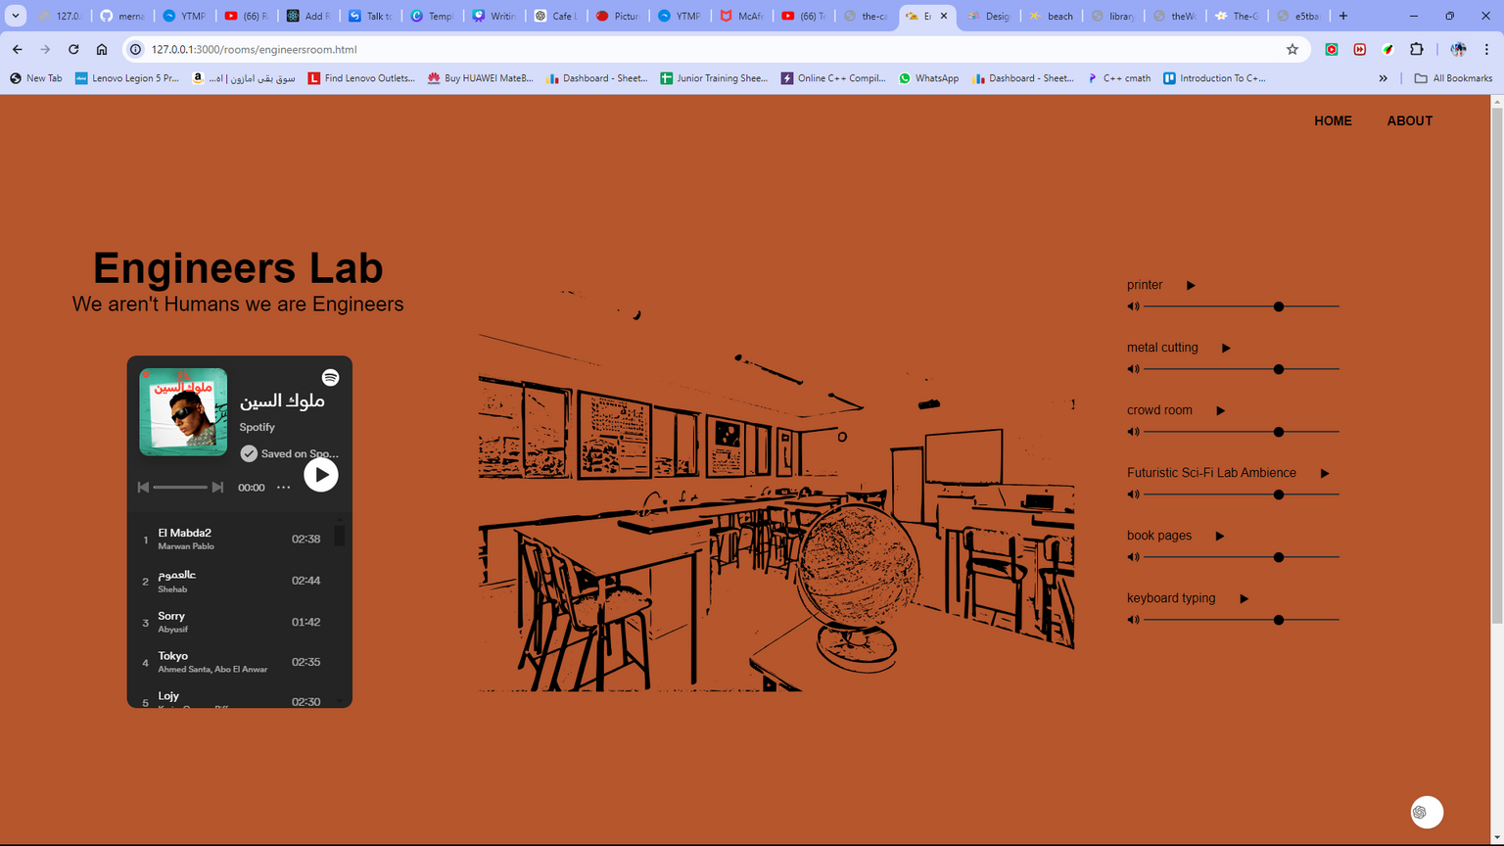

Slide 11
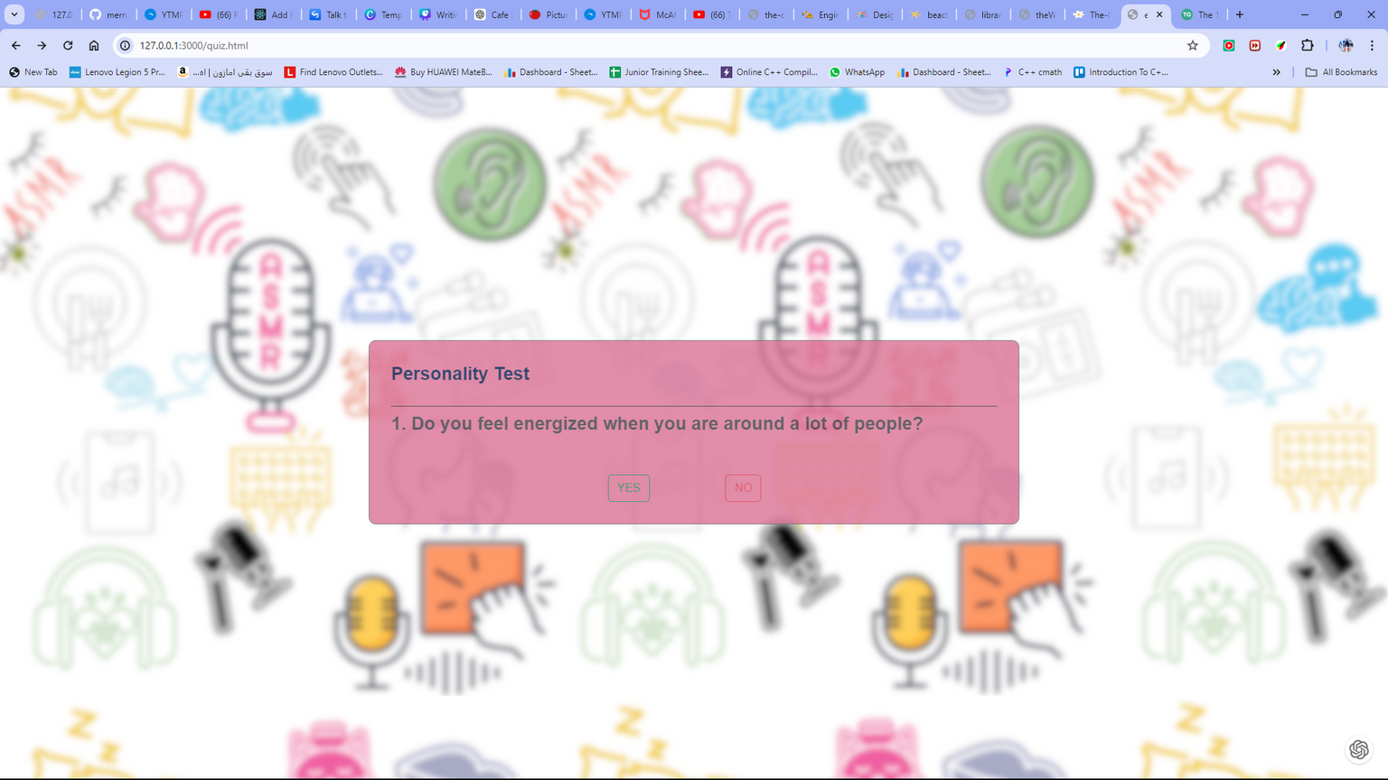

Slide 12


What is ASMR?
What is ASMR?
ASMR is a tingly feeling that travels from the top of the scalp down the back of the neck to the upper spine. It’s triggered by specific auditory or visual stimuli, such as whispering, tapping, and natural sounds.
Positive Responses
Stress and Anxiety Reduction.
Improvement in Short-Term Memory
Enhanced Productivity
Improved Concentration
Relaxation and Well-being

Slide 13


style, tone and formality
This website made in HTML ,
Styled : CSS ,
Functioned : Javascript
Designs : canva
Used a API called (spotify web API) as <iframe>

